Slide 1
Decision Trees
Core Concepts: Entropy, Information Gain & How Trees Split

Slide 2
What is a Decision Tree?
A Decision Tree is a flowchart-like model that splits data step by step based on feature values to make a prediction.
Root Node First split — the whole dataset
Example: Will the student pass???
Questions: Attended Class?
Did Homework?
Studied?
Wearing glasses?
Internal Node A decision/question on a feature
Leaf Node Final answer / class label
💡 Key Idea: At each node, the tree asks a YES/NO (or categorical) question about a feature and follows the branch that matches the data.

Slide 3
Entropy – Measuring Impurity
Entropy tells us how mixed (impure) a group is. High entropy = lots of different classes mixed together. Zero entropy = all same class (pure!).
Formula:
H(S) = − Σ pᵢ · log₂(pᵢ)
where pᵢ = proportion of class i in the set
All Same Class
Half & Half
Slightly Mixed
[5 Yes, 0 No]
[5 Yes, 5 No]
[7 Yes, 3 No]
H = 0
H = 1.0
H ≈ 0.88
Perfectly pure. No uncertainty.
Maximum uncertainty.
Some mix, less uncertain.
💡 Think of entropy like a coin: a fair coin (50-50) has the highest entropy. A two-headed coin has zero.

Slide 4
Information Gain – Which Feature to Split On?
Information Gain (IG) measures how much a feature reduces entropy after splitting. We pick the feature with the HIGHEST IG to split on.
IG(S, A) = H(S) − Σᵥ (|Sᵥ| / |S|) · H(Sᵥ)
H(S) = entropy before split Sᵥ = subset after split on value v of feature A
1
Calculate H(S)
Entropy of the whole dataset before any split.
2
Split by a feature
Divide data into subsets based on each value of that feature.
3
Calc H for each subset
Compute entropy of every resulting subset.
4
Weighted average
Weight each subset's entropy by its size and sum them up.
5
Subtract
IG = H(S) − weighted average. Bigger IG → better split!
✅ Best feature = the one that gives the highest information gain → chosen as the splitting node.

Slide 5
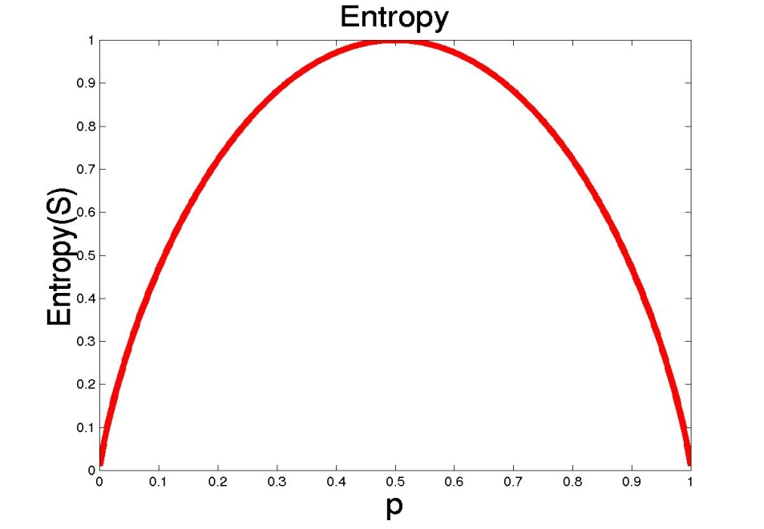
Entropy
S is a sample of training examples
p₊ is the proportion of positive examples
p₋ is the proportion of negative examples
Entropy measures the impurity of S
Entropy(S) = -p₊ log₂ p₊ - p₋ log₂ p₋

Slide 6
Entropy
Entropy(S)= expected number of bits needed to encode class (+ or -) of randomly drawn members of S (under the optimal, shortest length-code)
Why?
Information theory optimal length code assign
–log₂ p bits to messages having probability p.
So the expected number of bits to encode
(+ or -) of random member of S:
-p₊ log₂ p₊ - p₋ log₂ p₋
Note that: 0Log₂0 =0

Slide 7
Training Examples
Day
Outlook
Temp.
Humidity
Wind
Play Tennis
D1
Sunny
Hot
High
Weak
No
D2
Sunny
Hot
High
Strong
No
D3
Overcast
Hot
High
Weak
Yes
D4
Rain
Mild
High
Weak
Yes
D5
Rain
Cool
Normal
Weak
Yes
D6
Rain
Cool
Normal
Strong
No
D7
Overcast
Cool
Normal
Strong
Yes
D8
Sunny
Mild
High
Weak
No
D9
Sunny
Cool
Normal
Weak
Yes
D10
Rain
Mild
Normal
Weak
Yes
D11
Sunny
Mild
Normal
Strong
Yes
D12
Overcast
Mild
High
Strong
Yes
D13
Overcast
Hot
Normal
Weak
Yes
D14
Rain
Mild
High
Strong
No

Slide 8
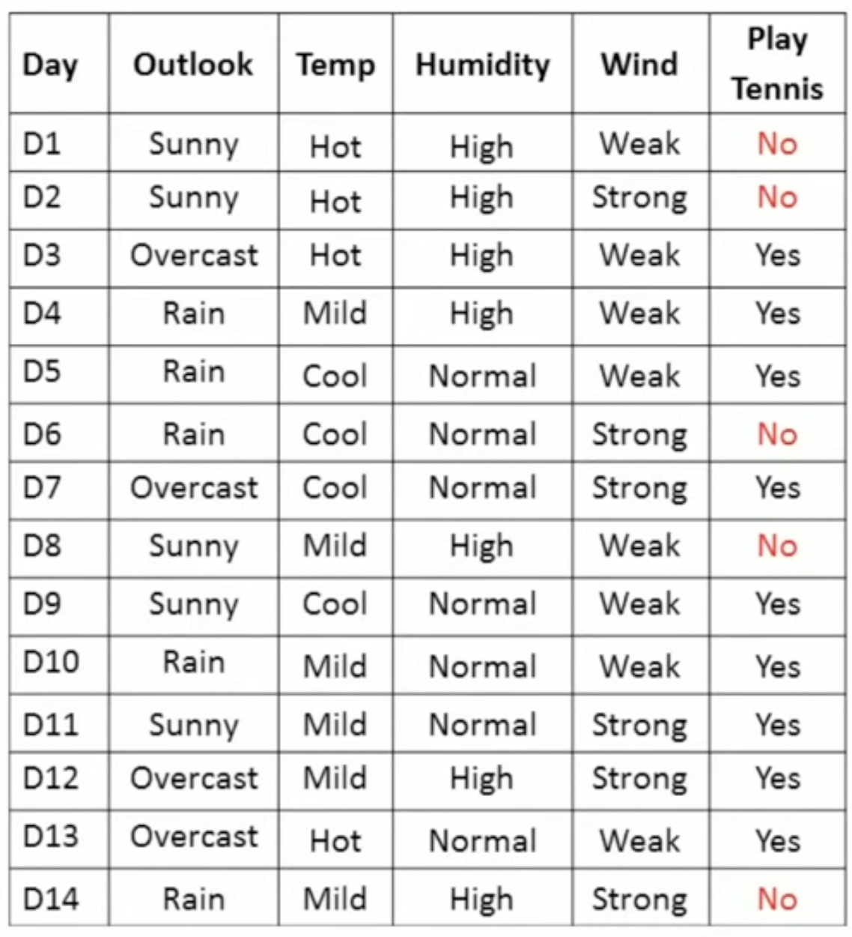
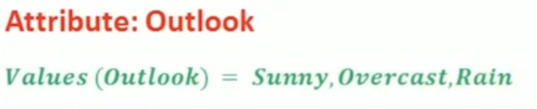
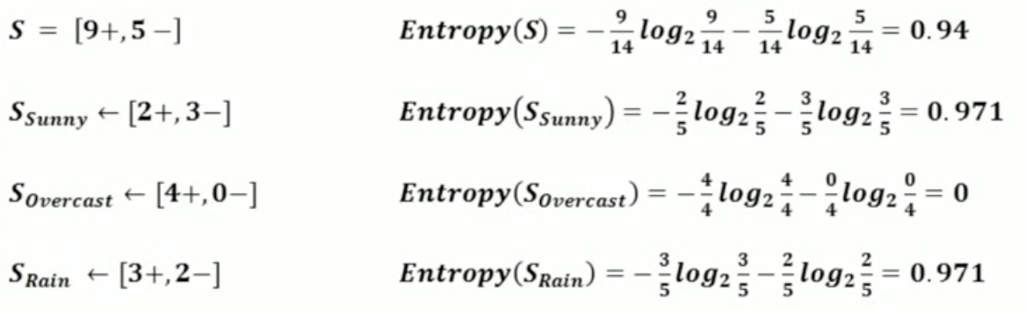
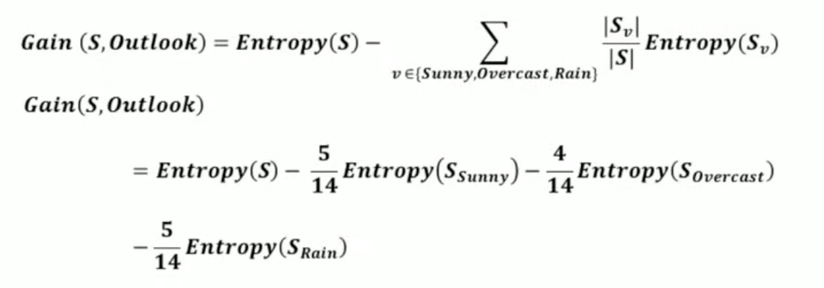
Gain(S,Outlook) =0.940-(5/14)*0.971 -(4/14)*0.0- (5/14)*0.0971=0.247

Slide 9
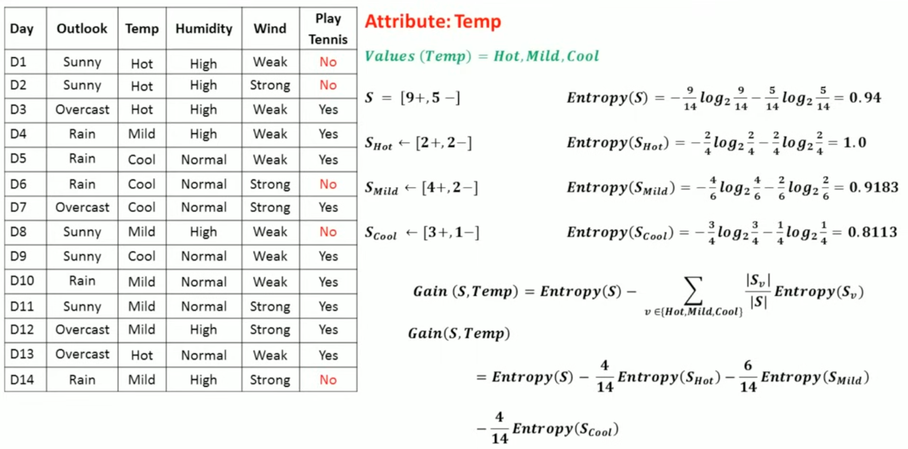
Gain(S,Temp) =0.940-(4/14)*1 -(6/14)*0.9183(4/14)*0.8113=0.247

Slide 10
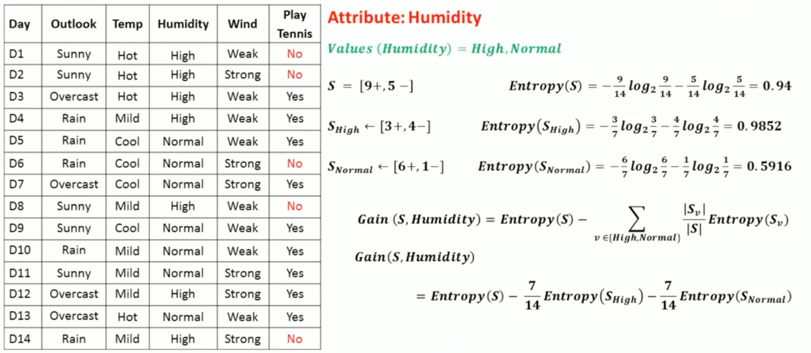
Gain(S,Humidity) =0.940-(7/14)*0.985 –(7/14)*0.592=0.151

Slide 11
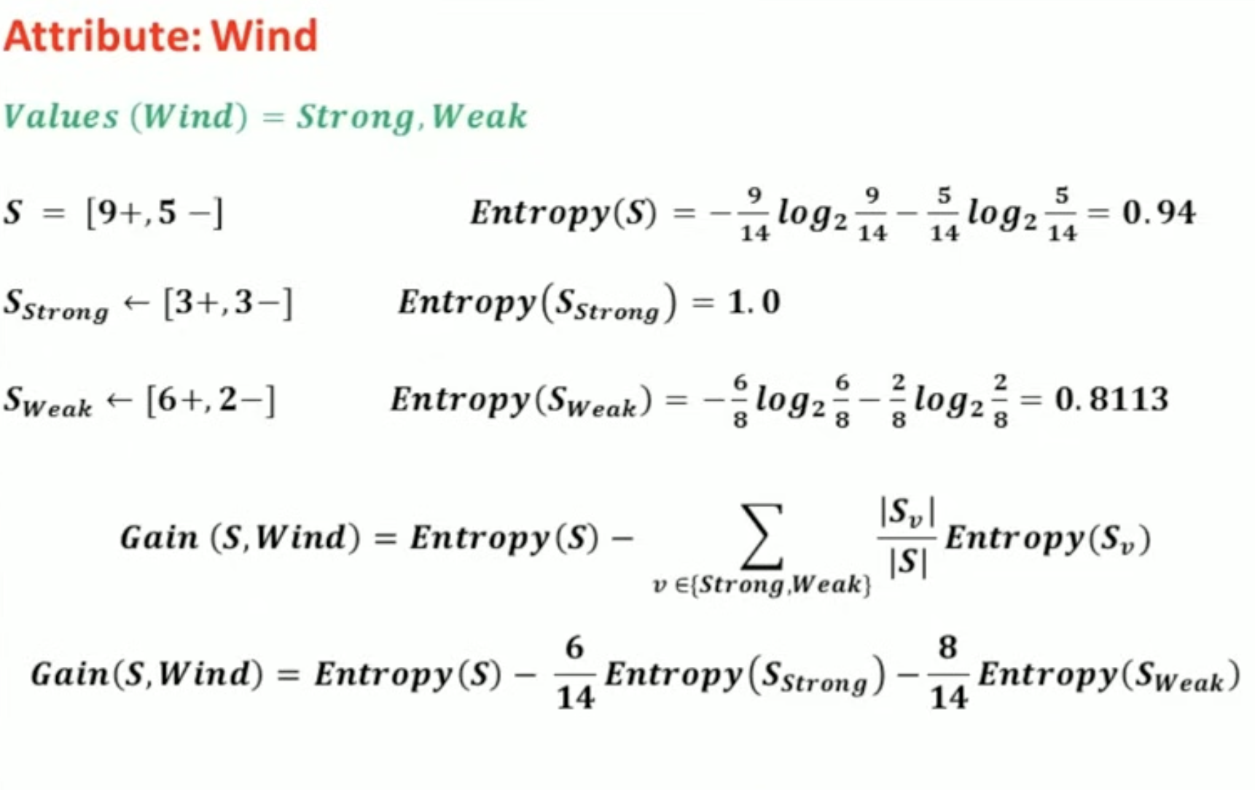
Gain(S,Wind) =0.940-(8/14)*0.811 – (6/14)*1.0=0.048

Slide 12
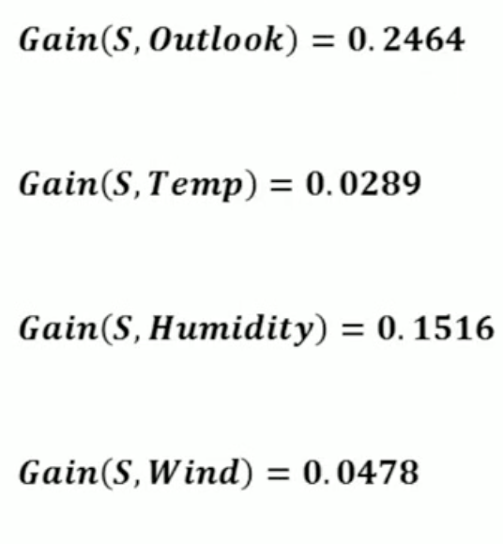
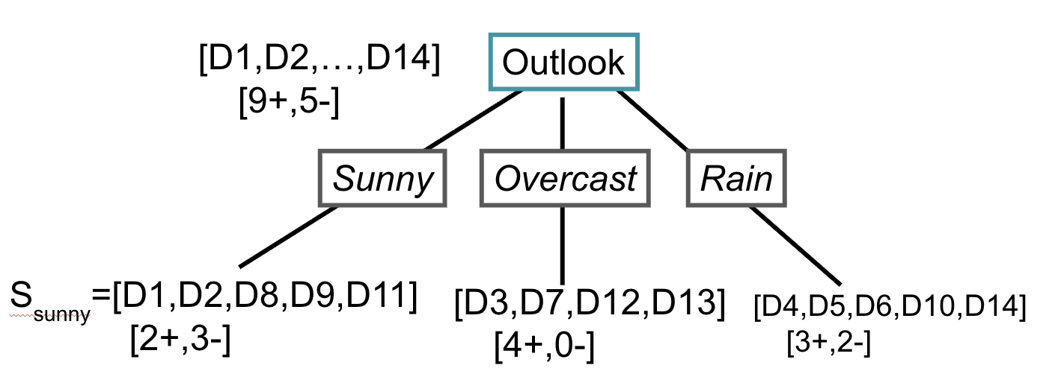
?
Yes
?

Slide 13
Training Examples
Day
Outlook
Temp.
Humidity
Wind
Play Tennis
D1
Sunny
Hot
High
Weak
No
D2
Sunny
Hot
High
Strong
No
D3
Overcast
Hot
High
Weak
Yes
D4
Rain
Mild
High
Weak
Yes
D5
Rain
Cool
Normal
Weak
Yes
D6
Rain
Cool
Normal
Strong
No
D7
Overcast
Cool
Normal
Strong
Yes
D8
Sunny
Mild
High
Weak
No
D9
Sunny
Cool
Normal
Weak
Yes
D10
Rain
Mild
Normal
Weak
Yes
D11
Sunny
Mild
Normal
Strong
Yes
D12
Overcast
Mild
High
Strong
Yes
D13
Overcast
Hot
Normal
Weak
Yes
D14
Rain
Mild
High
Strong
No

Slide 14
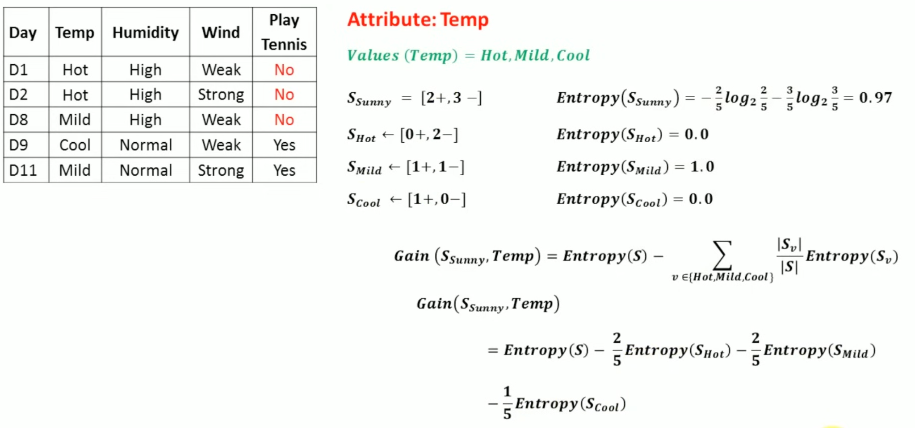
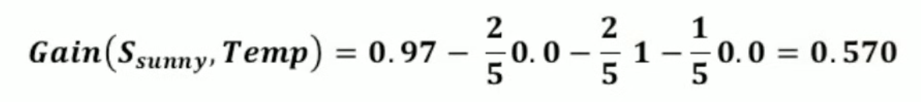

Slide 15
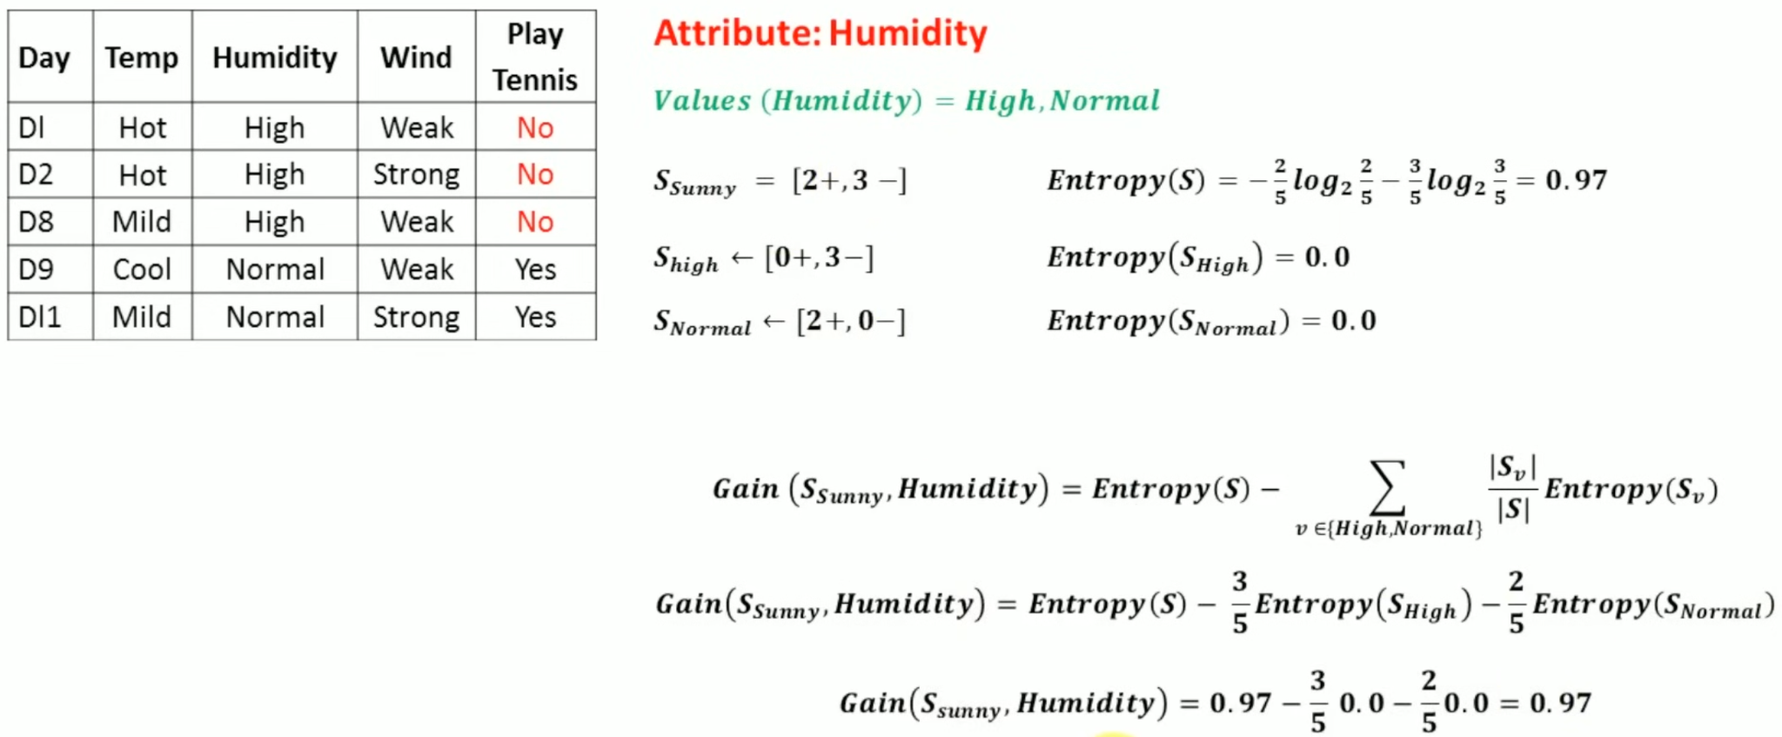

Slide 16
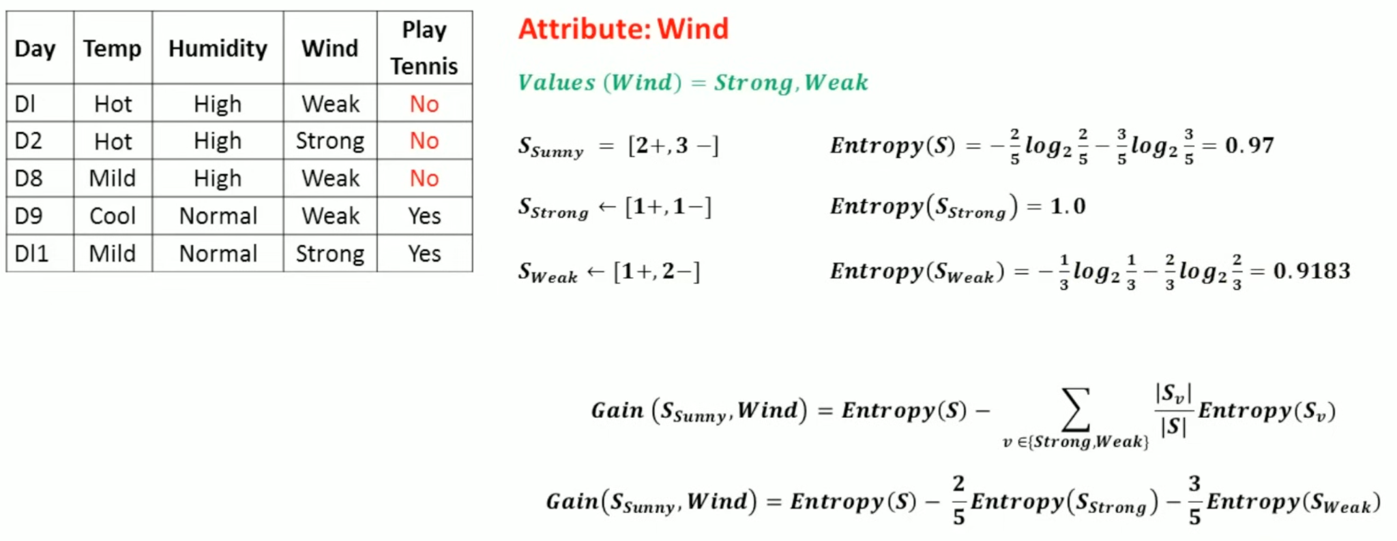

Slide 17
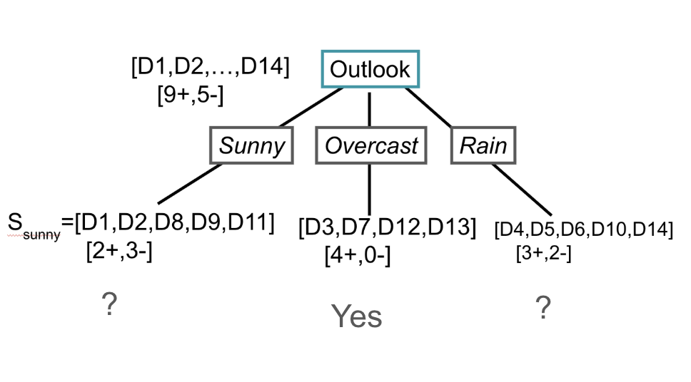
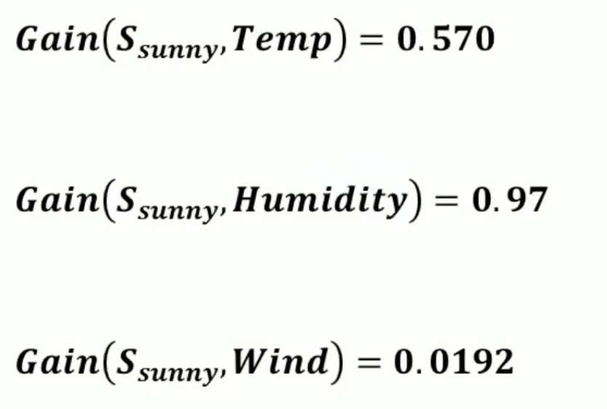
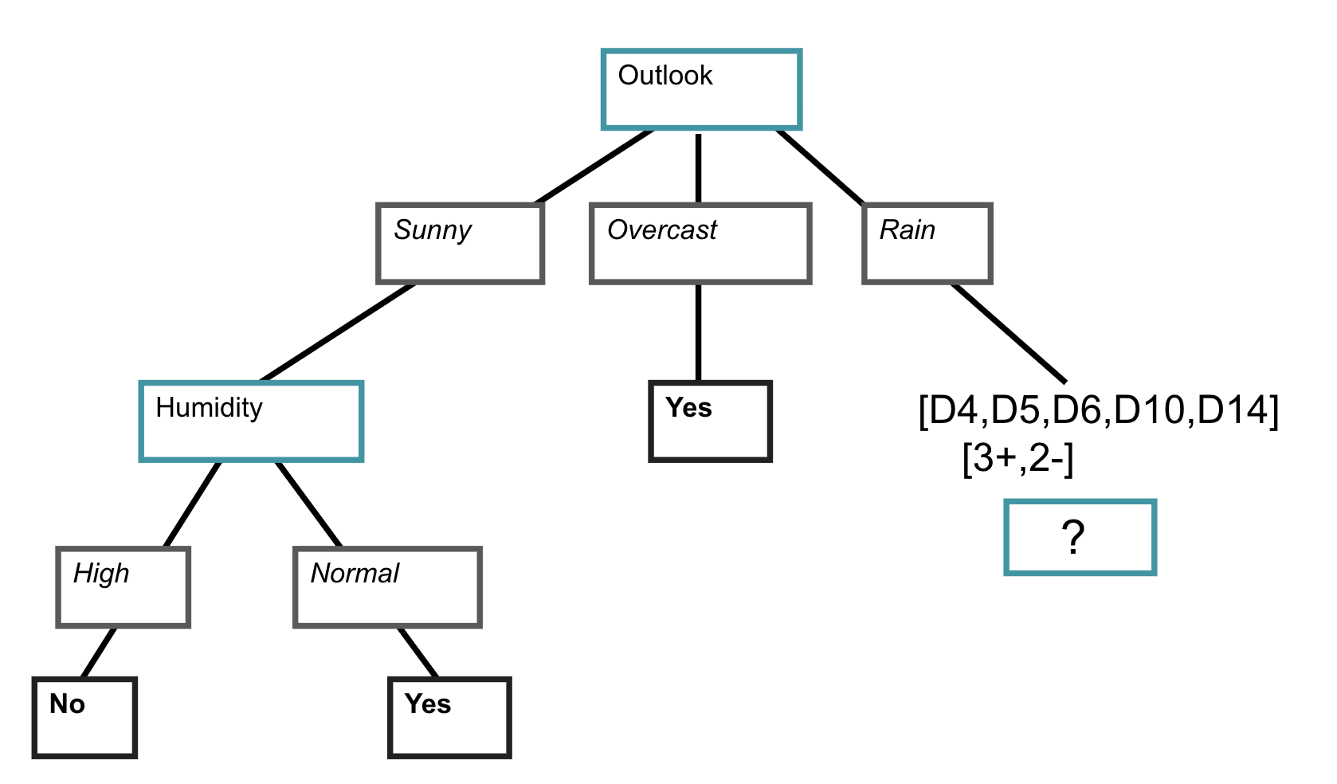

Slide 18
Training Examples
Day
Outlook
Temp.
Humidity
Wind
Play Tennis
D1
Sunny
Hot
High
Weak
No
D2
Sunny
Hot
High
Strong
No
D3
Overcast
Hot
High
Weak
Yes
D4
Rain
Mild
High
Weak
Yes
D5
Rain
Cool
Normal
Weak
Yes
D6
Rain
Cool
Normal
Strong
No
D7
Overcast
Cool
Normal
Strong
Yes
D8
Sunny
Mild
High
Weak
No
D9
Sunny
Cool
Normal
Weak
Yes
D10
Rain
Mild
Normal
Weak
Yes
D11
Sunny
Mild
Normal
Strong
Yes
D12
Overcast
Mild
High
Strong
Yes
D13
Overcast
Hot
Normal
Weak
Yes
D14
Rain
Mild
High
Strong
No

Slide 19
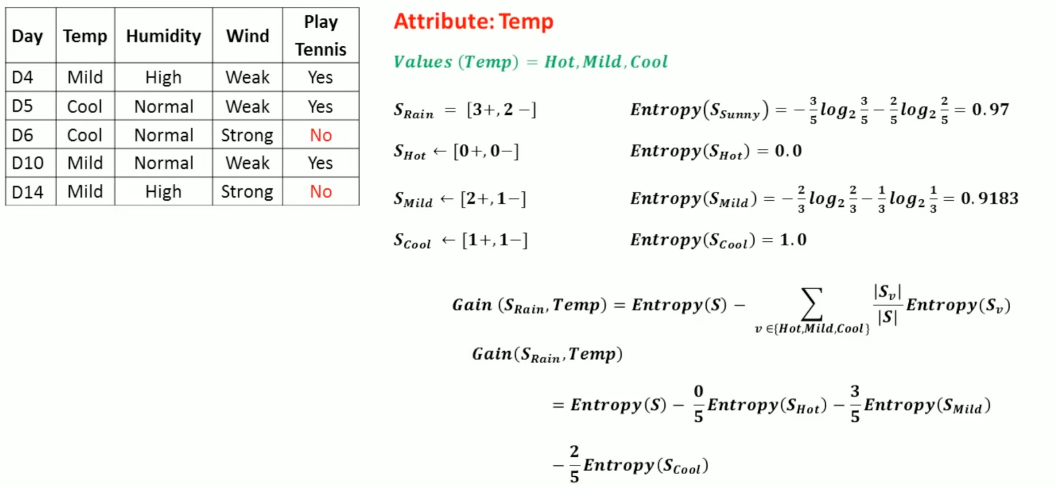
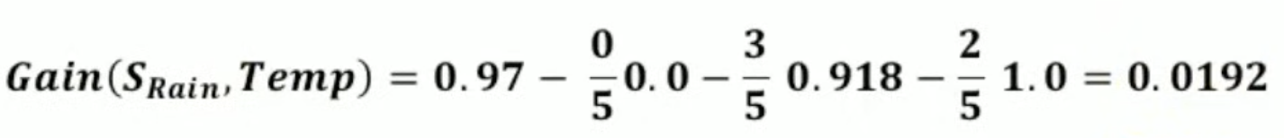

Slide 20
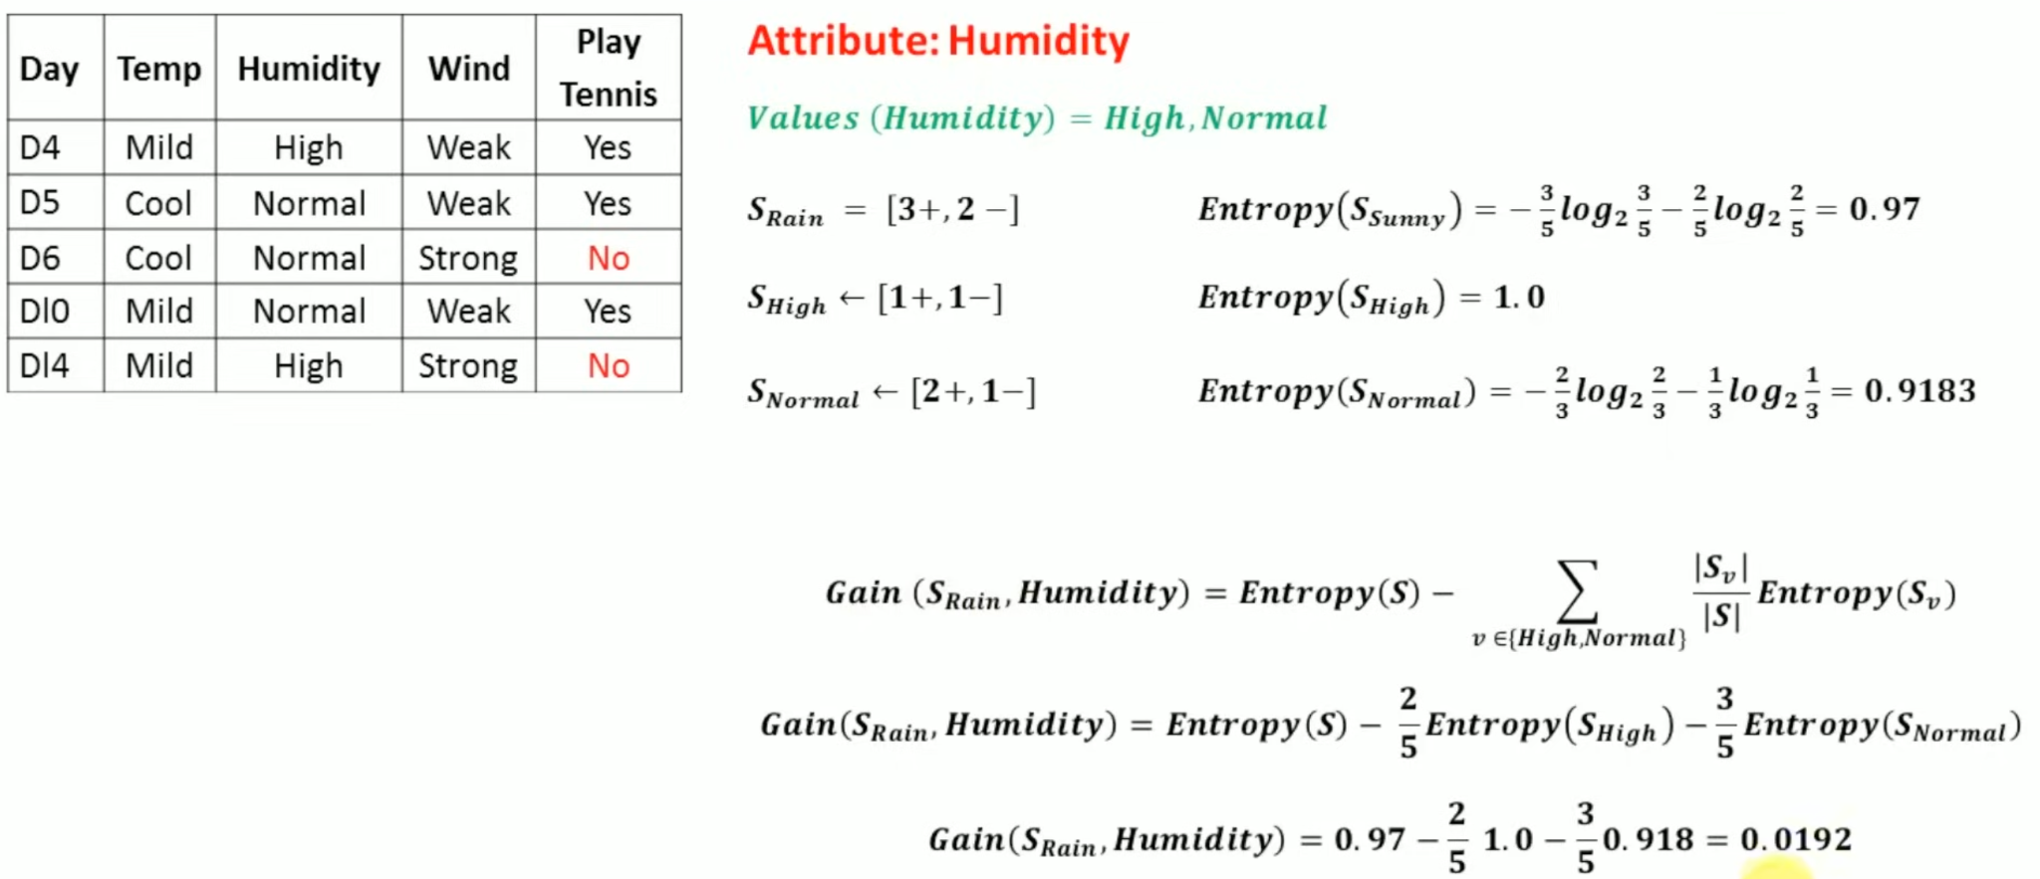

Slide 21
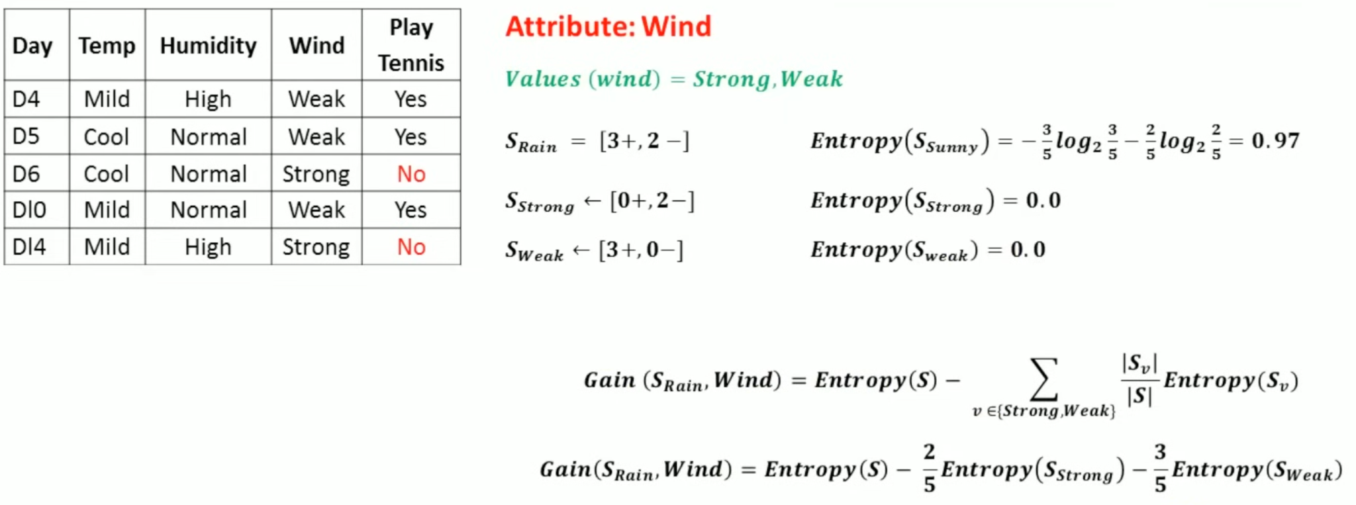
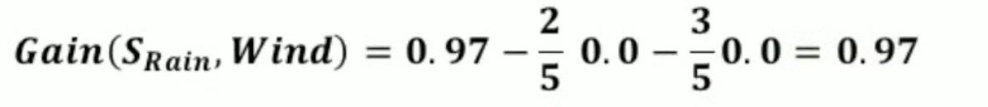

Slide 22
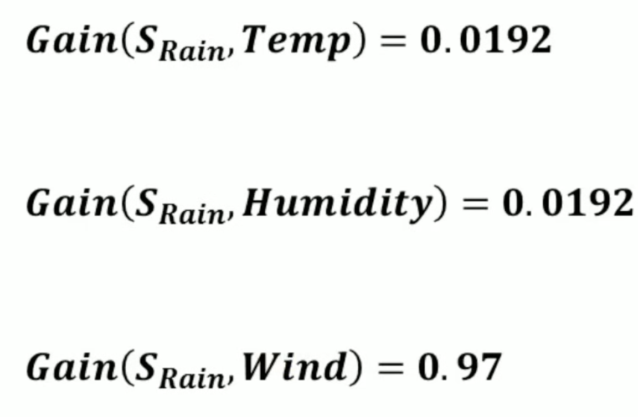
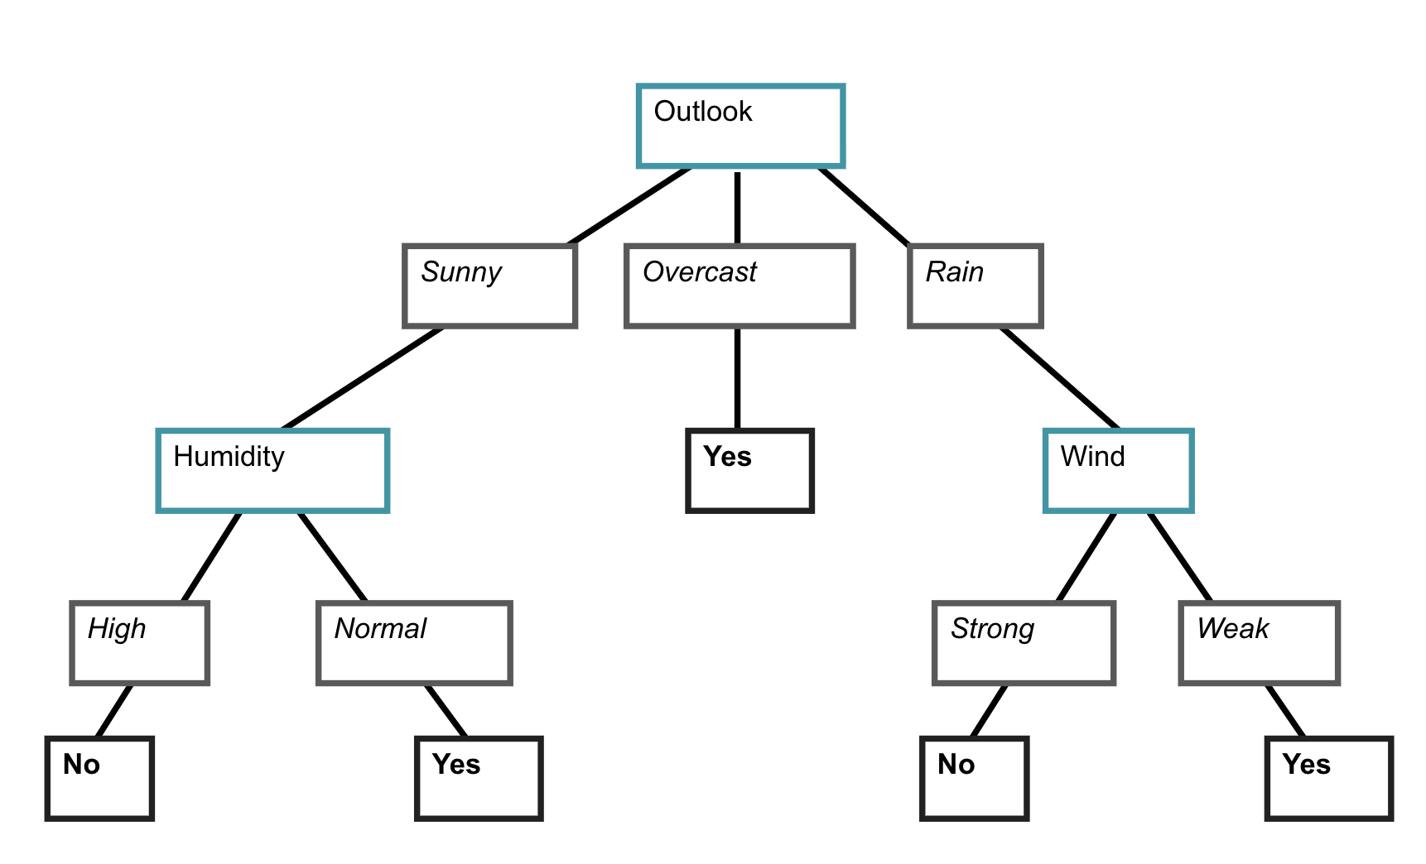

Slide 23
Outlook Temperature Humidity Wind PlayTennis
Sunny Hot High Weak ?
No
Outlook
Sunny
Overcast
Rain
Humidity
Yes
Wind
High
Normal
Strong
Weak
No
Yes
No
Yes

Slide 24
Quick Reference – Decision Tree Algorithm
Start
Begin with the full dataset at the Root Node
Calculate H(S)
Entropy of current node's data
For each feature
Compute IG = H(S) − weighted H after split
Choose feature
Pick the one with highest IG → create branch
Recurse
Repeat for each subset until pure or stopping condition met
Leaf nodes
Assign the majority class as the prediction
Formulas at a Glance
Entropy: H(S) = −Σ pᵢ log₂(pᵢ) Info Gain: IG(S,A) = H(S) − Σ (|Sᵥ|/|S|)·H(Sᵥ)

Slide 25
